Slide 1
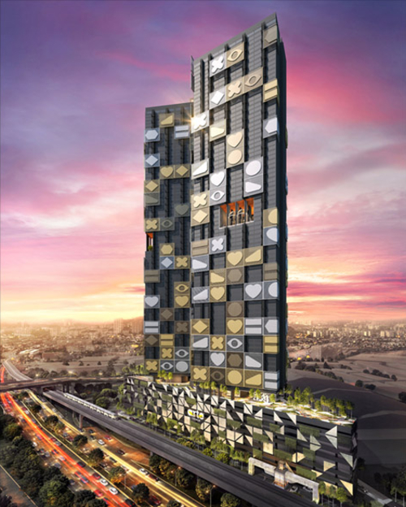
Towards an Optimum Attrition Rate Data Visualization
MOHD FIKRI BIN MOHD HANIM
MATRIC NO: MCS211043

Slide 2


Slide 3


Slide 4


Slide 5
BACKGROUND

Slide 6
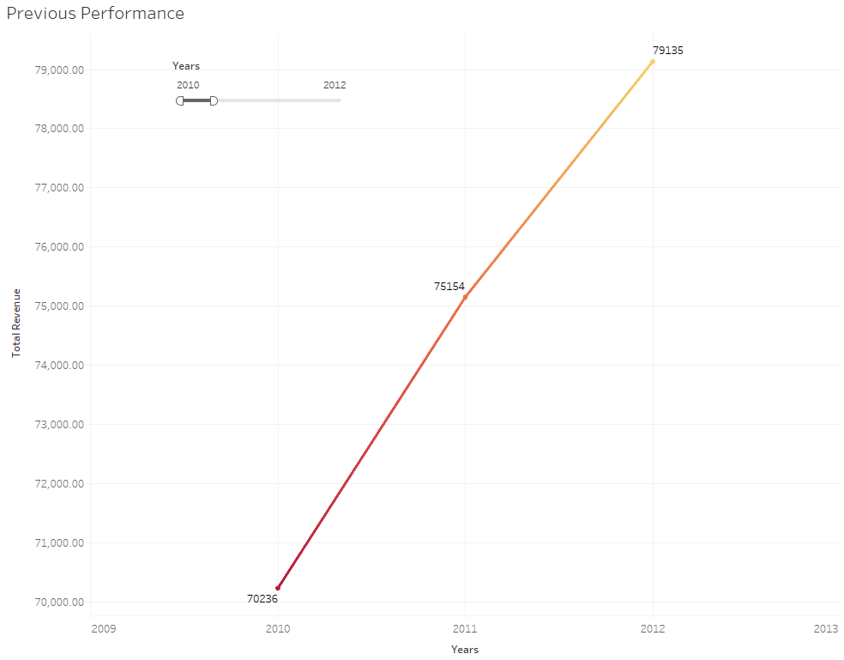
2010
2012
2014
2016
2018
2020
2022

Slide 7
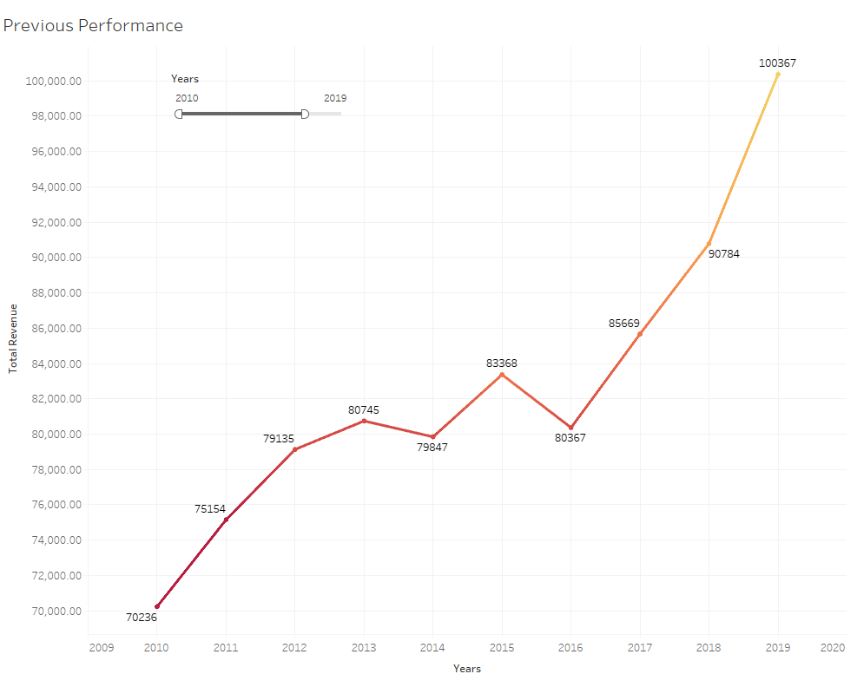
2010
2012
2014
2016
2018
2019
2020
2022

Slide 8
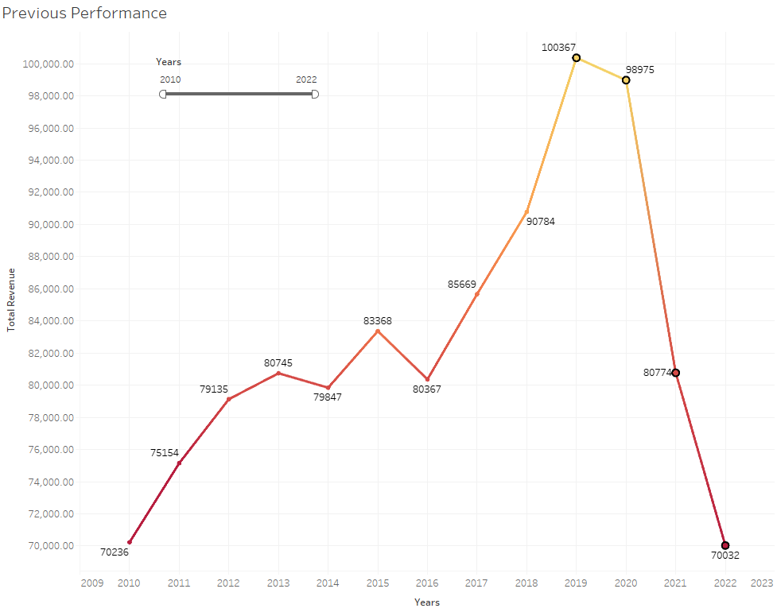
2010
2012
2014
2016
2018
2020
2022

Slide 9
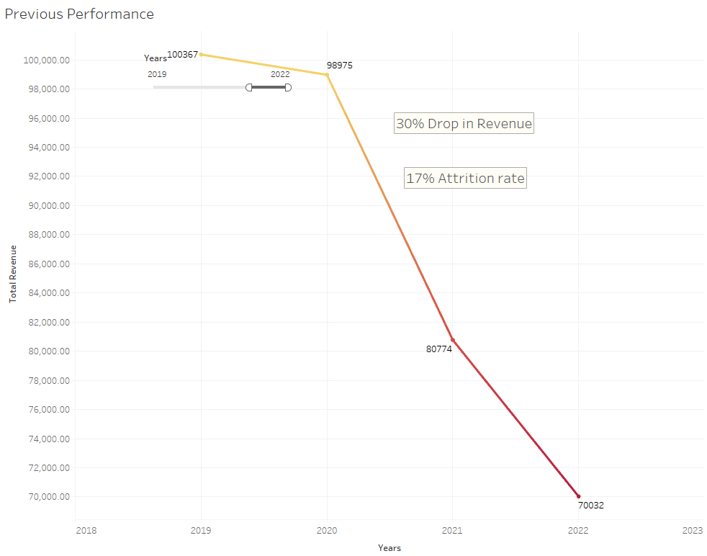
2010
2012
30% drop in revenue!
2014
17% Attrition rate
2016
2018
2019
2020
2022

Slide 10
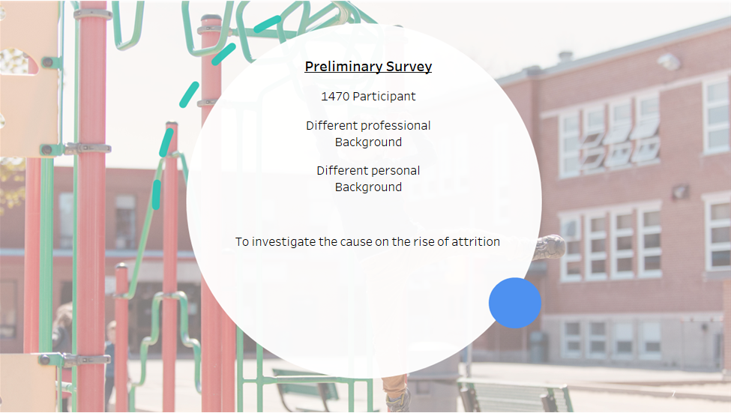

Slide 11
RESEARCH FINDING

Slide 12
OUR STRENGTH

Slide 13
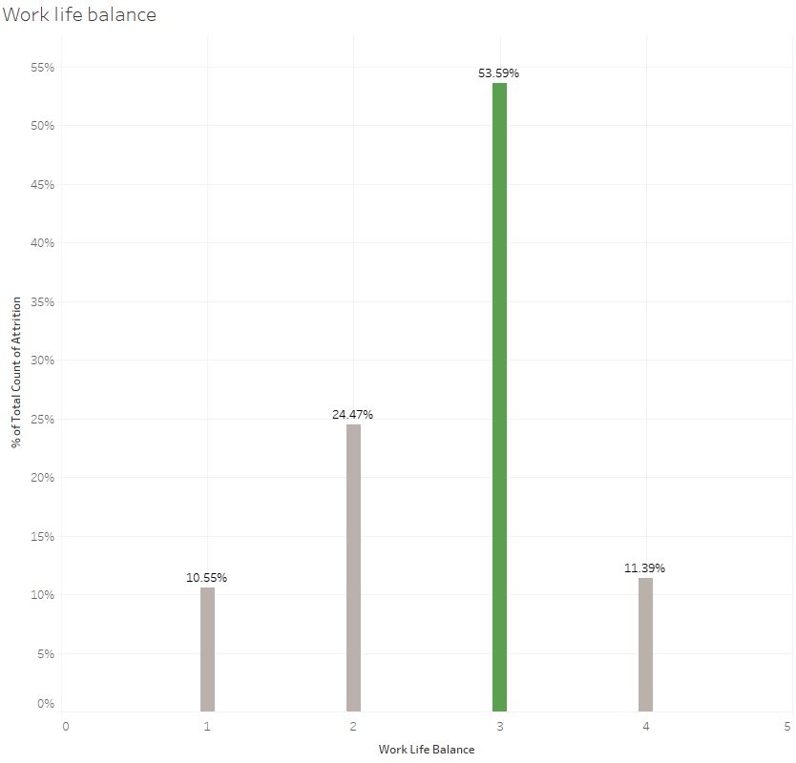
We have a good reputation for being good for work-life balance company

Slide 14
OUR PROBLEM

Slide 15
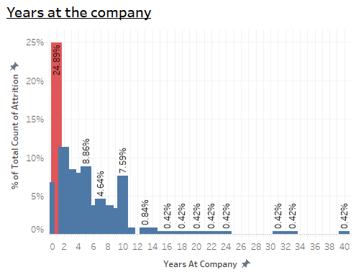
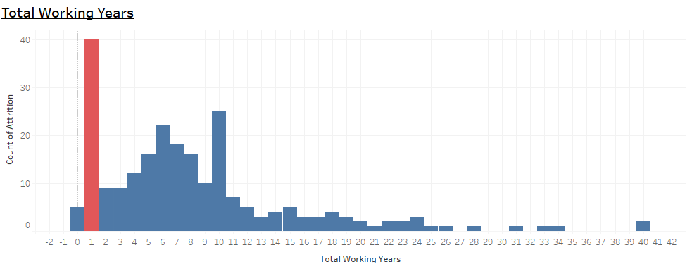
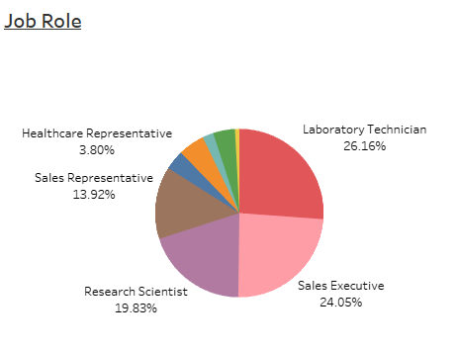
1
2
3

Slide 16
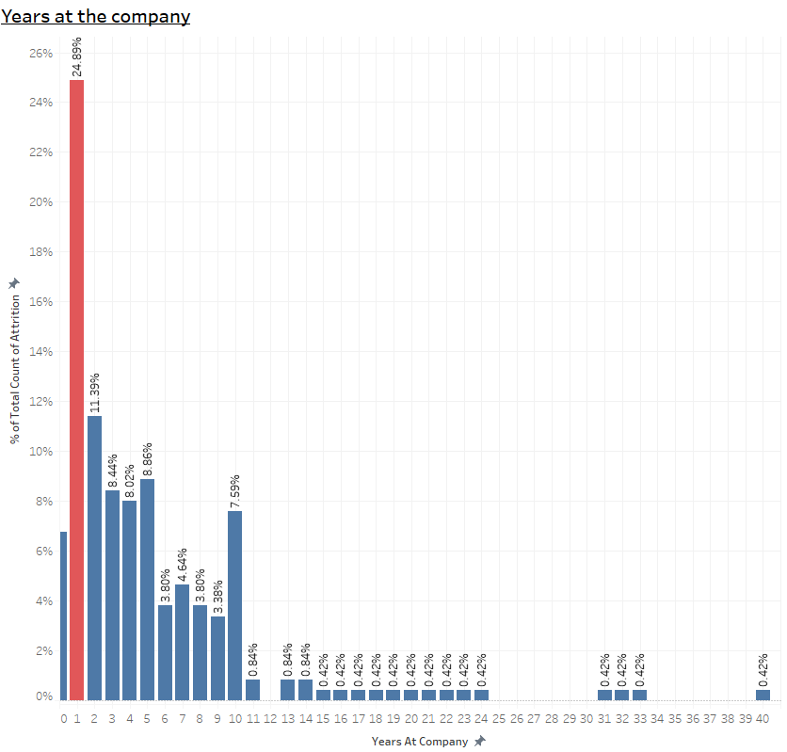
Years at The Company
Many Employees leave us before reaching 2nd year
This could be due to people jumping jobs?
The lowest attrition percentage was found after they have worked 14 years with the company

Slide 17
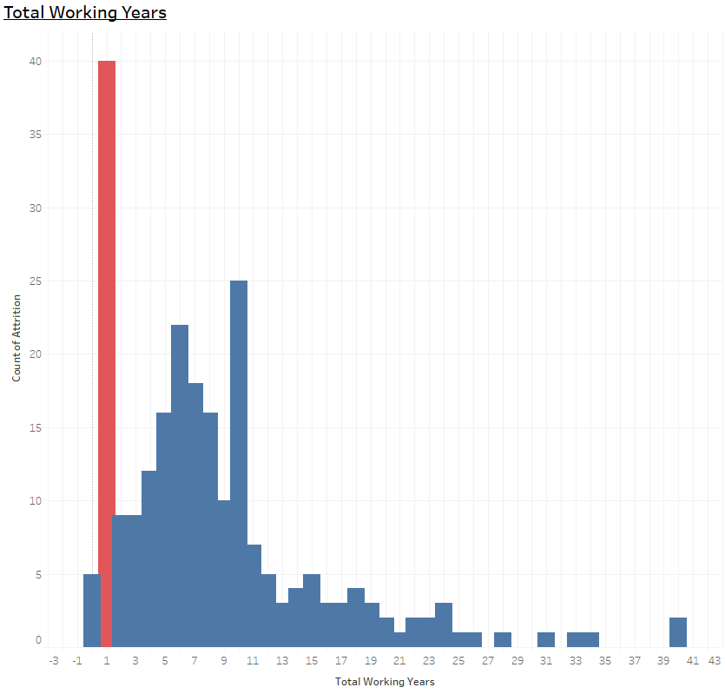
Total Working Years
Many fresh recruit are in their first year of working

Slide 18
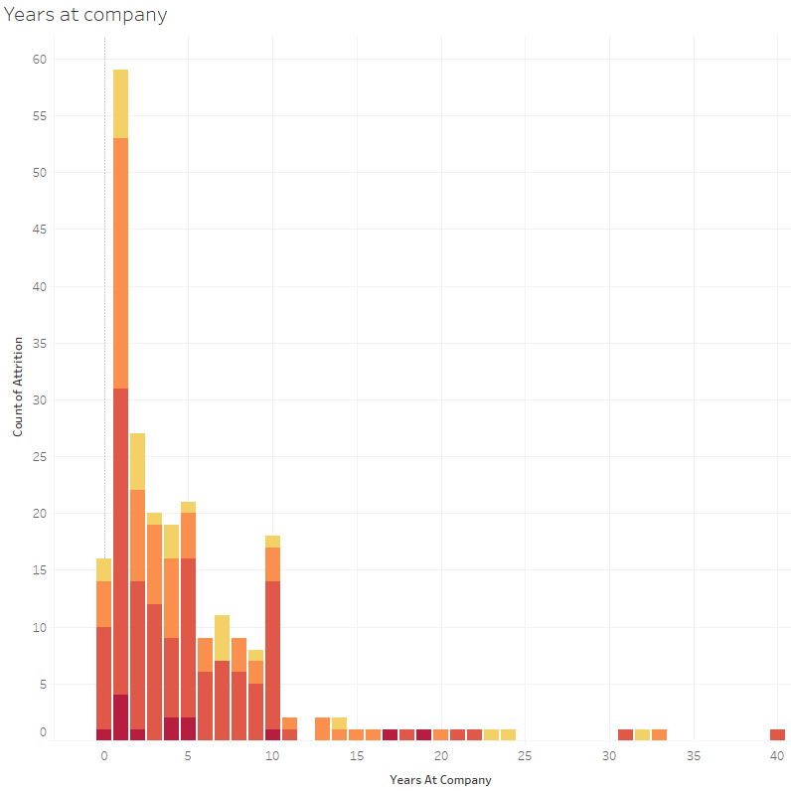
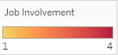
Years at The Company
Many new employee leave due to too much involvement with the work. This probably cause stress and

Slide 19
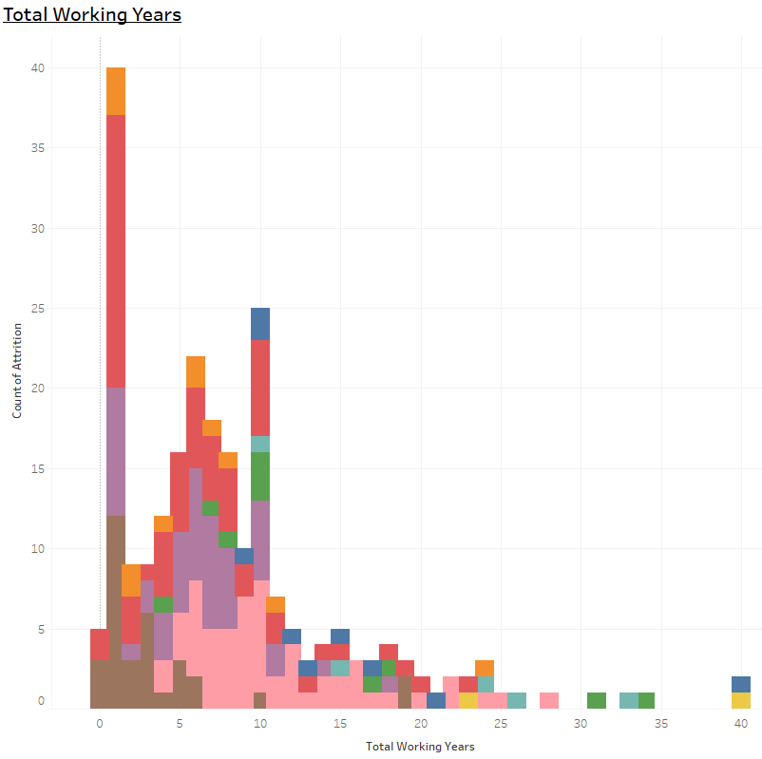
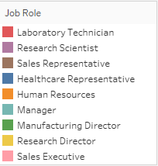
Total Working Years
Lab Technician contribute the most to the first-year attrition

Slide 20
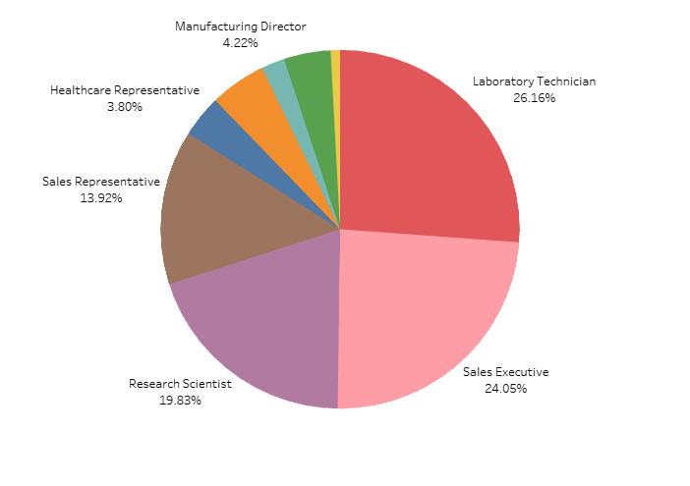
Job Role Distribution
Lab Technician contribute the most to the first-year attrition

Slide 21
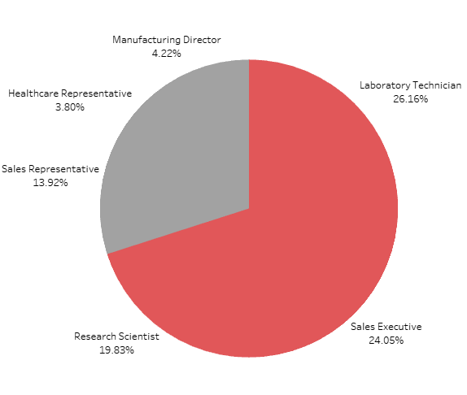
Job Role Distribution
Top 3 highest contributors to attrition
All 3 add up to 70%

Slide 22
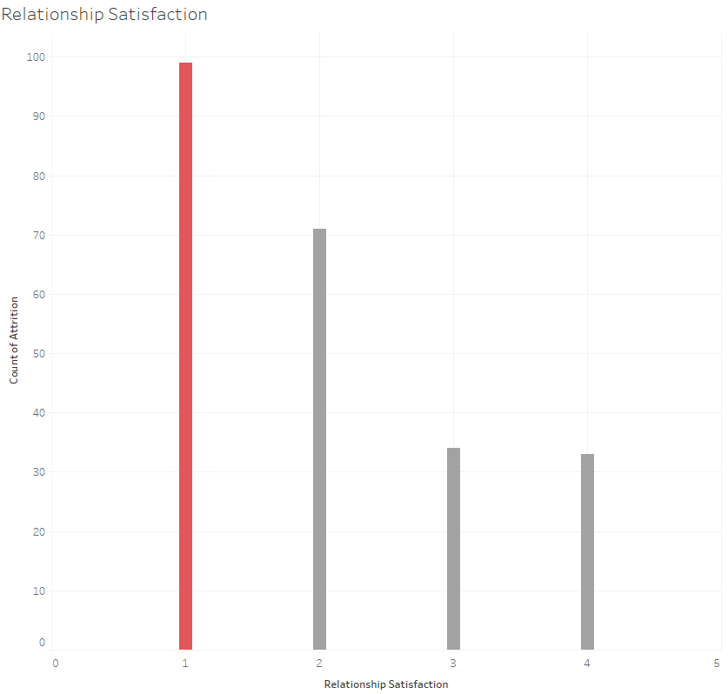
Personal Problem

Slide 23
NEXT STEP

Slide 24
NEXT STEP
Revamp employee benefit to be more beneficial to employee who stays
Establish a body or hire an external investigator to investigate top 3 job role with highest attrition
A better filtering mechanism from HR department for every job role

